Slide 1

Optimizations - Compilation for Embedded Processors -
Peter Marwedel
TU Dortmund
Informatik 12
Germany
© Springer, 2010
2014 年 01 月 17 日
These slides use Microsoft clip arts. Microsoft copyright restrictions apply.
Notes:
‹#›

Slide 2
Structure of this course
2: Specification & Modeling
Design repository
Design
3:
ES-hardware
8:
Test
Application Knowledge
6: Application mapping
5: Evaluation & validation & (energy, cost, performance, …)
7: Optimization
4: system software (RTOS, middleware, …)
Numbers denote sequence of chapters
Notes:
‹#›

Slide 3
Task-level concurrency management
Book section 7.1
Granularity: size of tasks (e.g. in instructions)
Readable specifications and efficient implementations can possibly require different task structures.
☞ Granularity changes
Notes:
‹#›

Slide 4
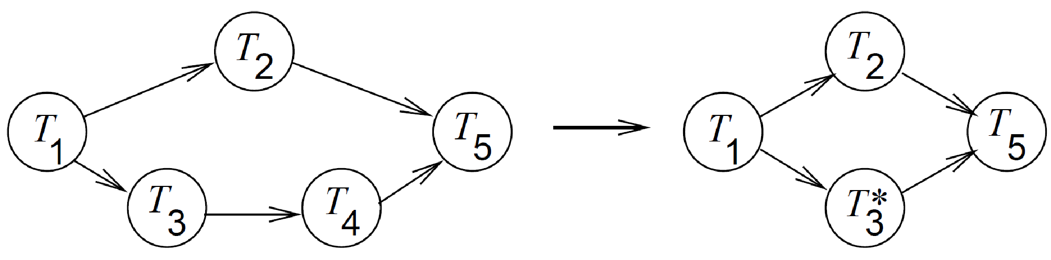
Merging of tasks
Reduced overhead of context switches,
More global optimization of machine code,
Reduced overhead for inter-process/task communication.
Notes:
‹#›

Slide 5
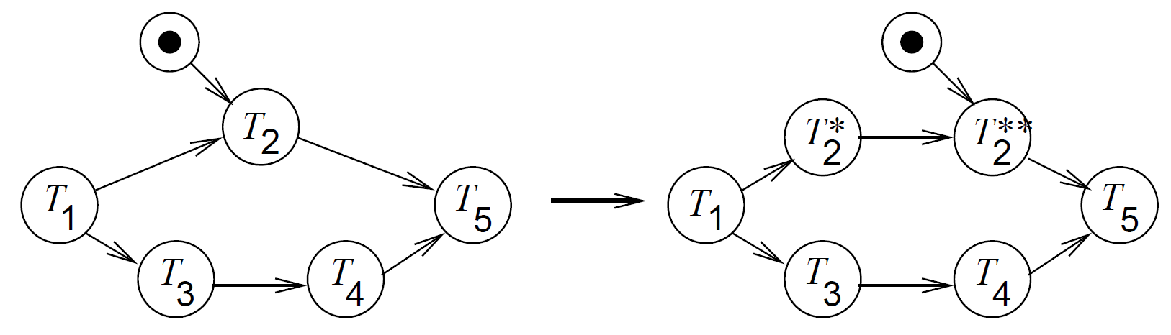
Splitting of tasks
No blocking of resources while waiting for input,
more flexibility for scheduling, possibly improved result.
Notes:
‹#›

Slide 6
Merging and splitting of tasks
The most appropriate task graph granularity depends upon the context ☞ merging and splitting may be required.
Merging and splitting of tasks should be done automatically, depending upon the context.
Notes:
‹#›

Slide 7
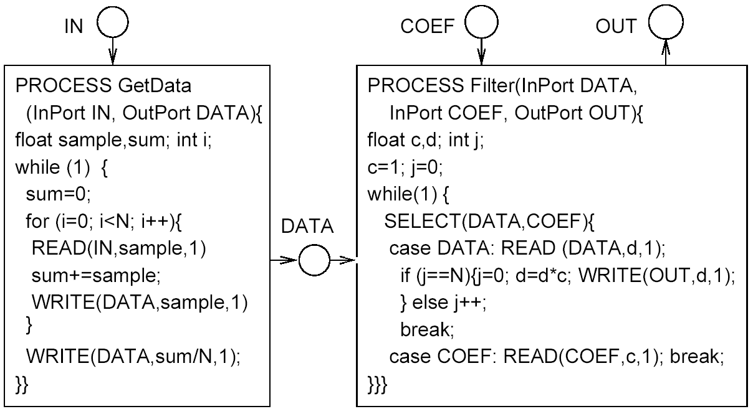
Automated rewriting of the task system - Example -
Notes:
‹#›

Slide 8
Attributes of a system that needs rewriting
Tasks blocking after they have already started running
Notes:
‹#›

Slide 9
Work by Cortadella et al.
Transform each of the tasks into a Petri net,
Generate one global Petri net from the nets of the tasks,
Partition global net into “sequences of transitions”
Generate one task from each such sequence
Mature, commercial approach not yet available
Notes:
‹#›

Slide 10
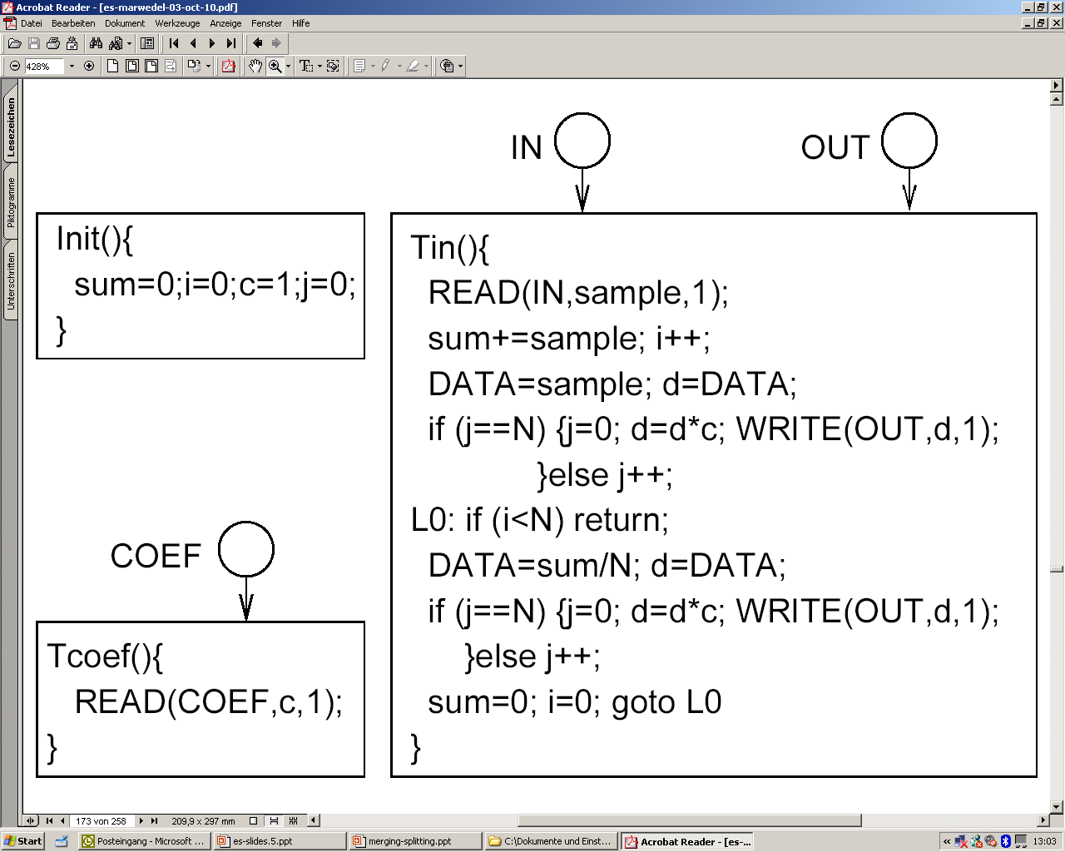
Result, as published by Cortadella
Reads only at the beginning
Initialization task
Never true
Always true
Notes:
‹#›

Slide 11
Optimized version of Tin
Never true
Tin () {
READ (IN, sample, 1);
sum += sample; i++;
DATA = sample; d = DATA;
L0: if (i < N) return;
DATA = sum/N; d = DATA;
d = d*c; WRITE(OUT,d,1);
sum = 0; i = 0;
return;
}
j==i-1
j ☞ i
Always true
Notes:
‹#›

Slide 12
High-level software transformations
Peter Marwedel
TU Dortmund
Informatik 12
Germany
© Springer, 2010
These slides use Microsoft clip arts. Microsoft copyright restrictions apply.
Notes:
‹#›

Slide 14
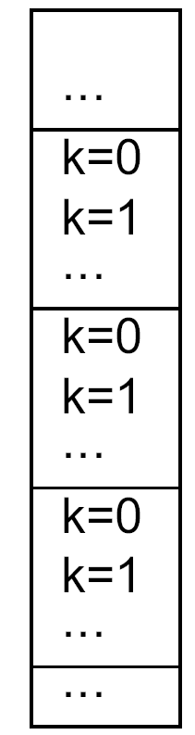
Impact of memory allocation on efficiency
Array p[j][k]
Column major order (FORTRAN)
Row major order (C)
…
_{j=0}
_{j=1}
…
_{j=0}
_{k=0}
_{j=0}
_{j=1}
…
_{j=1}
_{k=1}
_{j=0}
_{j=1}
…
_{j=2}
_{k=2}
…
Notes:
‹#›

Slide 15
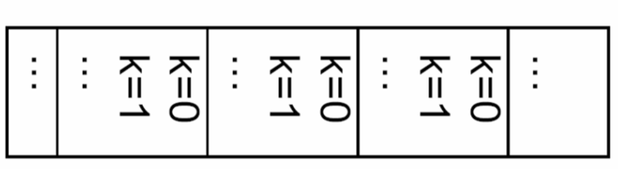
Best performance of innermost loop corresponds to rightmost array index
Two loops, assuming row major order (C):
for (k=0; k<=m; k++) for (j=0; j<=n; j++)
for (j=0; j<=n; j++) ) for (k=0; k<=m; k++)
p[j][k] = ... p[j][k] = ...
Same behavior for homogeneous memory access, but:
_{j=2}
_{j=1}
_{j=0}
For row major order
↑ Poor cache behavior
Good cache behavior ↑
☞ memory architecture dependent optimization
Notes:
‹#›

Slide 16
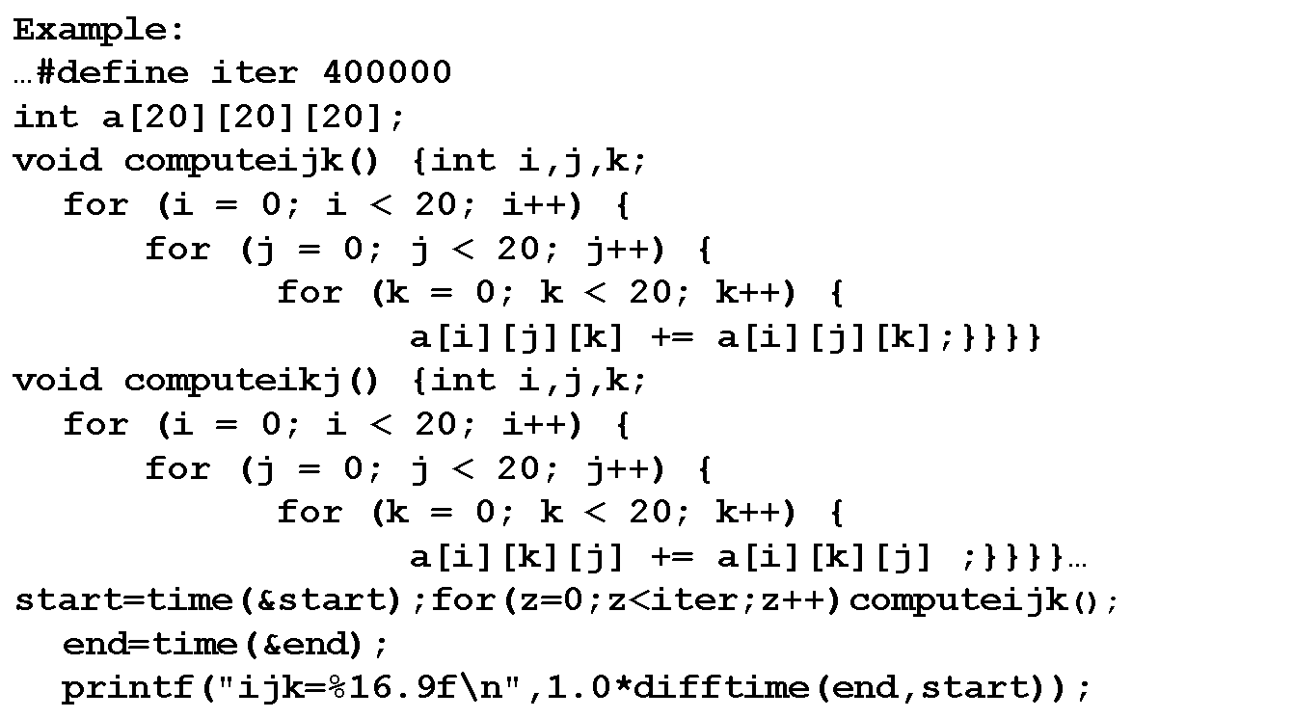
☞ Program transformation “Loop interchange”
☞ Improved locality
(SUIF interchanges array indexes instead of loops)

Slide 17
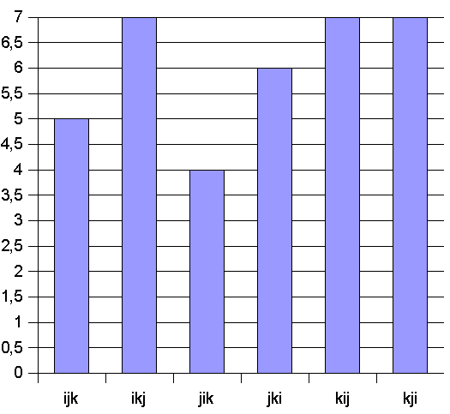
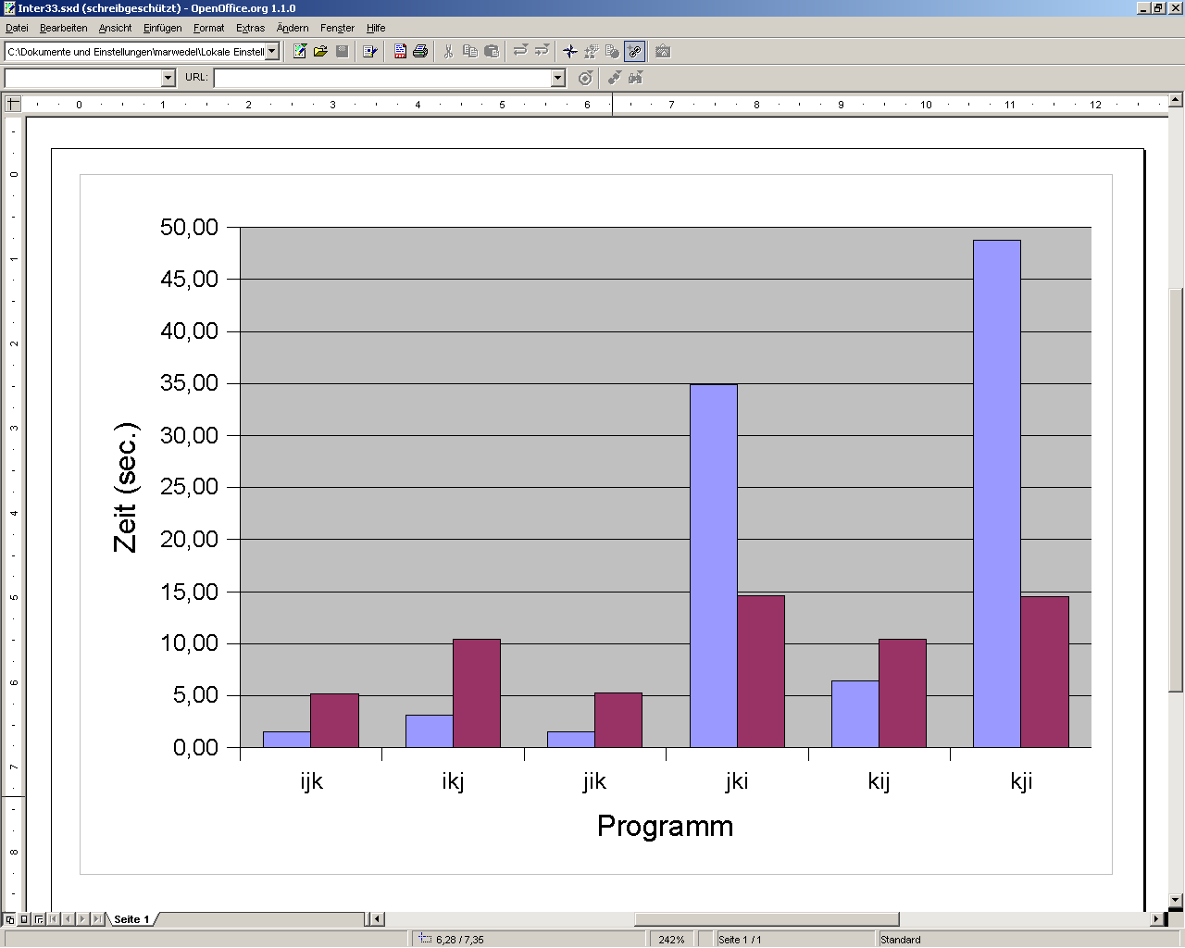
Results: strong influence of the memory architecture
Loop structure: i j k
Dramatic impact of locality
Processor reduction to [%]
Ti C6xx ~ 57%
Sun SPARC 35%
Intel Pentium
3.2 %
Time [s]
Not always the same impact ..
[Till Buchwald, Diploma thesis, Univ. Dortmund, Informatik 12, 12/2004]

Slide 18
Transformations “Loop fusion” (merging), “loop fission”
for(j=0; j<=n; j++) for (j=0; j<=n; j++)
p[j]= ... ; {p[j]= ... ;
for (j=0; j<=n; j++) , p[j]= p[j] + ...}
p[j]= p[j] + ...
Loops small enough to Better locality for
allow zero overhead access to p.
Loops Better chances for
parallel execution.
Which of the two versions is best?
Architecture-aware compiler should select best version.

Slide 19
Example: simple loops
#define size 30
#define iter 40000
int a[size][size];
float b[size][size];
void ms1() {int i,j;
for (i=0;i< size;i++){
for (j=0;j<size;j++){
a[i][j]+=17; }
for (j=0;j<size;j++){
b[i][j]-=13; }}}
void ss1() {int i,j;
for (i=0;i<size;i++){
for (j=0;j<size;j++){
a[i][j]+= 17;}}
for(i=0;i<size;i++){
for (j=0;j<size;j++){
b[i][j]-=13;}}}
void mm1() {int i,j;
for(i=0;i<size;i++){
for(j=0;j<size;j++){
a[i][j] += 17;
b[i][j] -= 13;}}}

Slide 20
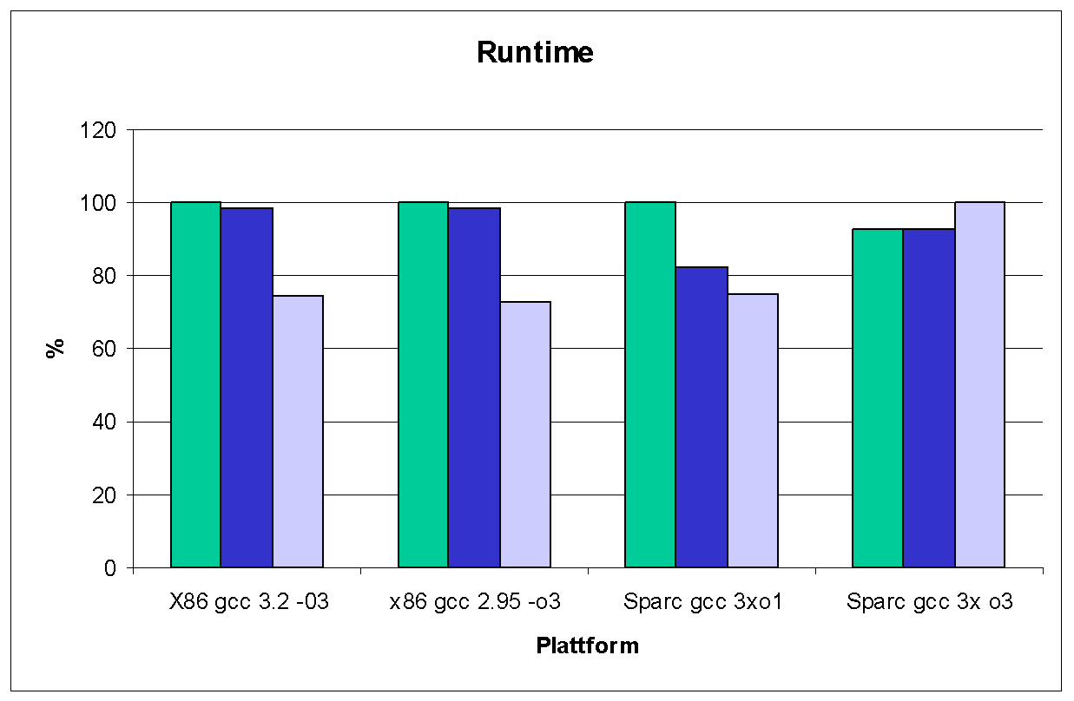
Results: simple loops
ss1
(100% ≙ max)
☞ Merged loops superior; except Sparc with –o3
ms1
mm1

Slide 21
Loop unrolling
for (j=0; j<=n; j++)
p[j]= ... ;
for (j=0; j<=n; j+=2)
{p[j]= ... ; p[j+1]= ...} factor = 2
Better locality for access to p.
Less branches per execution of the loop. More opportunities for optimizations.
Tradeoff between code size and improvement.
Extreme case: completely unrolled loop (no branch).

Slide 22
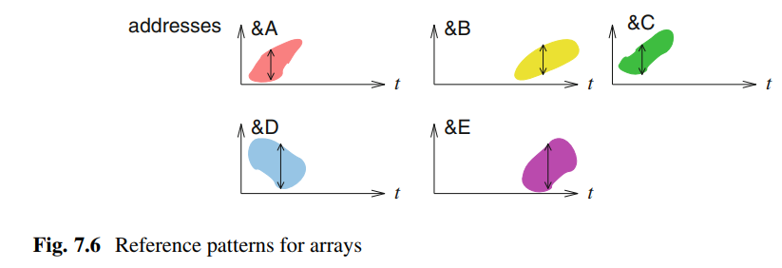
Array Folding

Slide 23
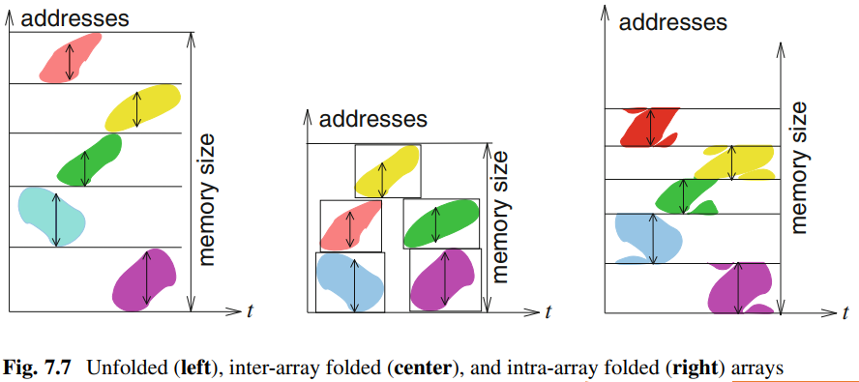
Array Folding
Array
Index
A
B
C
D
E
0
1
2
3
0
1
2
0
1
2
0
1
2
3
0
1
2
3

Slide 24
Energy-aware compilation (1): Optimization for low-energy the same as for high performance?
No !
High-performance if available memory bandwidth fully used; low-energy consumption if memories are at stand-by mode
Reduced energy if more values are kept in registers
ADD r3,r0,r2
MOV r0,#28
MOV r2,r12
MOV r12,r11
MOV r11,rr10
MOV r0,r9
MOV r9,r8
MOV r8,r1
LDR r1, [r4, r0]
ADD r0,r3,r1
ADD r4,r4,#4
ADD r5,r5,#1
CMP r5,#100
BLT LL3
LDR r3, [r2, #0]
ADD r3,r0,r3
MOV r0,#28
LDR r0, [r2, r0]
ADD r0,r3,r0
ADD r2,r2,#4
ADD r1,r1,#1
CMP r1,#100
BLT LL3
int a[1000];
c = a;
for (i = 1; i < 100; i++) {
b += *c;
b += *(c+7);
c += 1;
}
2096 cycles
19.92 µJ
2231 cycles
16.47 µJ
Notes:
‹#›

Slide 25
Energy-aware compilation (2)
Operator strength reduction: e.g. replace * by + and <<
Minimize the bitwidth of loads and stores
Standard compiler optimizations with energy as a cost function
R2:=a[0]; for i:= 1 to 10 do begin R1:= a[i]; C:= 2 * R1 + R2; R2 := R1; end;
E.g.: Register pipelining:
for i:= 0 to 10 do C:= 2 * a[i] + a[i-1];
Exploitation of the memory hierarchy
Notes:
‹#›

Slide 26
Energy-aware compilation (3)
Energy-aware scheduling: the order of the instructions can be changed as long as the meaning does not change. Goal: reduction of the number of signal transitions Popular (can be done as a post-pass optimization with no change to the compiler).
Energy-aware instruction selection: among valid instruction sequences, select those minimizing energy consumption
Exploitation of the memory hierarchy: huge difference between the energy consumption of small and large memories

Slide 27
Exploitation of parallel address computations
Generic address generation unit (AGU) model
Instruction Field
Parameters:
k = # address registers
m = # modify registers
1
Cost metric for AGU operations:
Address Register File
Operation cost
immediate AR load 1
immediate AR modify 1
auto-increment/ 0 decrement
AR += MR 0
Modify Register File
+/-
Memory
Notes:
‹#›

Slide 28
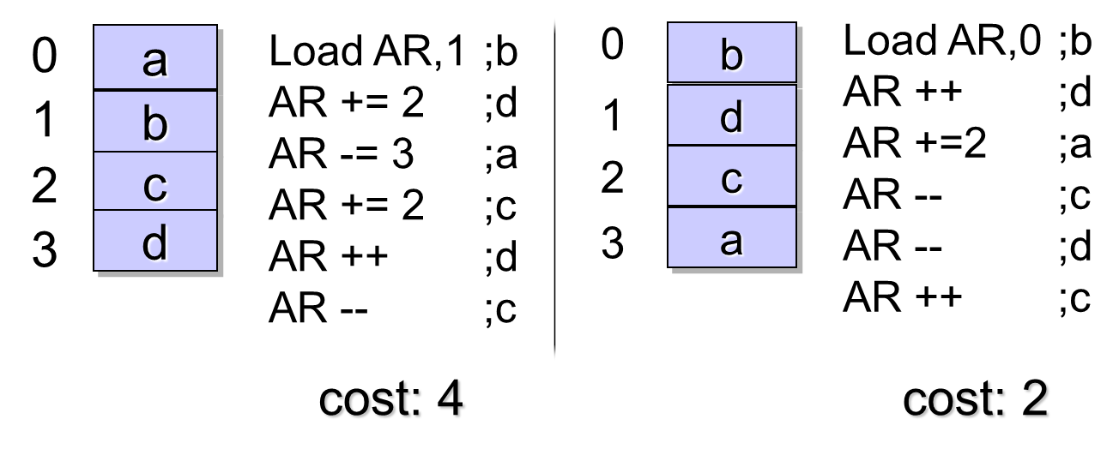
☞ SOA example - Effect of optimised memory layout -
Variables in a basic block:
Access sequence:
V = {a, b, c, d}
S = (b, d, a, c, d, c)
Notes:
‹#›

Slide 29
SOA example: Access sequence, access graph and Hamiltonian paths
access sequence: b d a c d c
a
b
a
b
0
b
1
1
d
1
1
1
1
2
c
2
2
a
3
c
d
c
d
access graph
maximum weighted path= max. weighted Hamilton path covering (MWHC)
memory layout
SOA used as a building block for more complex situations
significant interest in good SOA algorithms
[Bartley, 1992; Liao, 1995]
Notes:
‹#›

Slide 30
Naïve SOA
Nodes are added in the order in which they are used in the program.
Example: Access sequence: S = (b, d, a, c, d, c)
1
0
0
0
1
1
0
b
1
d
b
d
a
c
2
a
0 1 2 3
3
c
memory layout
Notes:
‹#›

Slide 31
Liao’s algorithm
Similar to Kruskal’s spanning tree algorithms: 1. Sort edges of access graph G=(V,E) according to their weight 2. Construct a new graph G’=(V’,E’), starting with E’=0 3. Select an edge e of G of highest weight; If this edge does not cause a cycle in G’ and does not cause any node in G’ to have a degree > 2 then add this node to E’ otherwise discard e. 4. Goto 3 as long as not all edges from G have been selected and as long as G’ has less than the maximum number of edges (|V|-1). Example: Access sequence: S=(b, d, a, c, d, c)
1
0
1
0
0
0
G
G‘
a
b
2 (c,d) 1 (a,c) 1 (a,d) 1 (b,d)
a
b
1
Implicit edges of weight 0 for all unconnected nodes.
1
1
1
1
2
2
c
d
c
d
Notes:
‹#›

Slide 32
Liao’s algorithm on a more complex graph
a b c d e f a d a d a c d f a d
G
G’
2
2
a
f
a
f
1
1
1
5
5
1
b
e
b
e
1
1
1
1
c
d
c
d
2
2
Notes:
‹#›

